Slide 1

About the Presentations
The presentations cover the objectives found in the opening of each chapter.
All chapter objectives are listed in the beginning of each presentation.
You may customize the presentations to fit your class needs.
Some figures from the chapters are included. A complete set of images from the book can be found on the Instructor Resources disc.

Slide 2
Oracle 11g: SQL
Chapter 3
Table Creation and Management

Slide 3
Objectives
Identify the table name and structure
Create a new table using the CREATE TABLE command
Use a subquery to create a new table
Add a column to an existing table
Modify the definition of a column in an existing table
Delete a column from an existing table
Oracle 11g: SQL

Slide 4
Objectives (continued)
Mark a column as unused and then delete it at a later time
Rename a table
Truncate a table
Drop a table
Oracle 11g: SQL

Slide 5
Database Table
A database object
Stores data for the database
Consists of columns and rows
Created and modified through data definition language (DDL) commands
Oracle 11g: SQL

Slide 6
Table Design
Table and column names:
  Can contain a maximum 30 characters – no blank spaces
  Must begin with a letter
  Can contain numbers, underscore (_), and number sign (#)
  Must be unique
  No reserved words are allowed
Oracle 11g: SQL

Slide 7
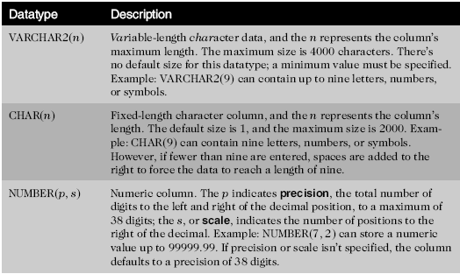
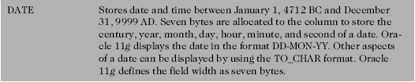
Table Design (continued)
Oracle 11g: SQL

Slide 8

Table Creation
Oracle 11g: SQL

Slide 9
Defining Columns
Column definition list must be enclosed in parentheses
Datatype must be specified for each column
Maximum of 1,000 columns
Oracle 11g: SQL

Slide 10
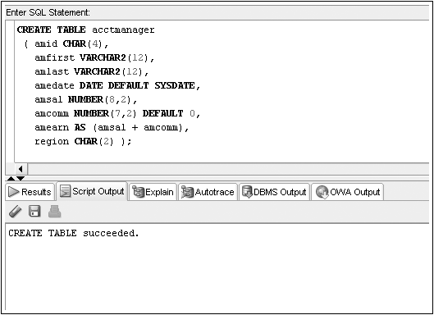
CREATE TABLE Command Example
Virtual Column
Oracle 11g: SQL

Slide 11
Viewing List of Tables: USER_TABLES
A data dictionary is a typical component of a DBMS that maintains information about database objects
You can query the data dictionary to verify all the tables that exist in your schema
The USER_TABLES data dictionary object maintains information regarding all your tables
Oracle 11g: SQL

Slide 12
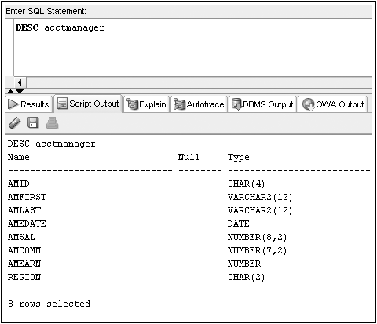
Viewing Table Structures: DESCRIBE
DESCRIBE displays the structure of a specified table
Oracle 11g: SQL

Slide 13
Table Creation through Subqueries
You can use subqueries to retrieve data from an existing table
Requires use of AS keyword
New column names can be assigned
Oracle 11g: SQL

Slide 14
CREATE TABLE…AS
Oracle 11g: SQL

Slide 15
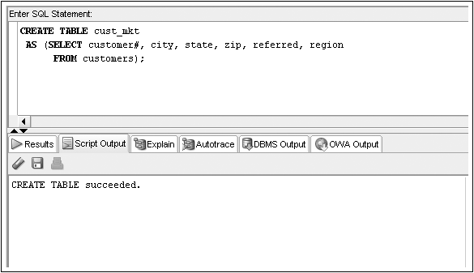
CREATE TABLE…AS Command Example
Oracle 11g: SQL

Slide 16
Modifying Existing Tables
Accomplished through the ALTER TABLE command
Use an ADD clause to add a column
Use a MODIFY clause to change a column
Use a DROP COLUMN to drop a column
Oracle 11g: SQL

Slide 17
ALTER TABLE Command Syntax
Oracle 11g: SQL

Slide 18
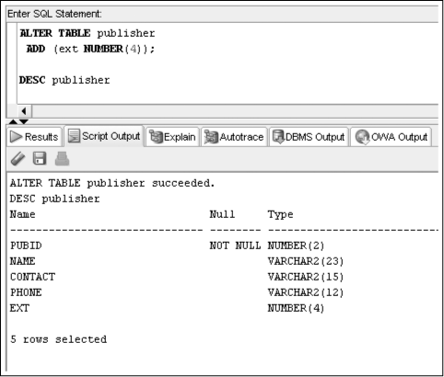
ALTER TABLE…ADD Command
Oracle 11g: SQL

Slide 19
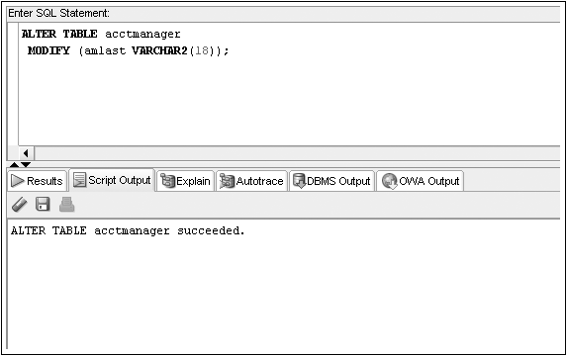
ALTER TABLE…MODIFY Command
Oracle 11g: SQL

Slide 20
Modification Guidelines
Column must be as wide as the data it already contains
If a NUMBER column already contains data, size cannot be decreased
Adding or changing default data does not affect existing data
Oracle 11g: SQL

Slide 21
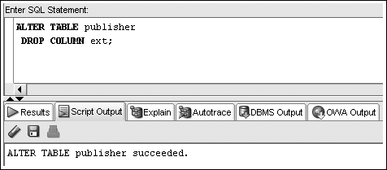
ALTER TABLE…DROP COLUMN Command
Can only reference one column per execution
Deletion is permanent
Cannot delete last remaining column in a table
Oracle 11g: SQL

Slide 22
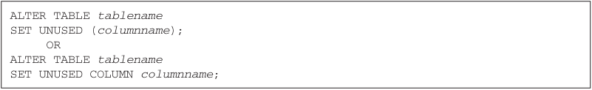
ALTER TABLE…SET UNUSED Command
Once marked for deletion, a column cannot be restored
Storage space is freed at a later time
Oracle 11g: SQL

Slide 23
ALTER TABLE…DROP UNUSED Command
Frees up storage space from columns previously marked as unused
Oracle 11g: SQL

Slide 24
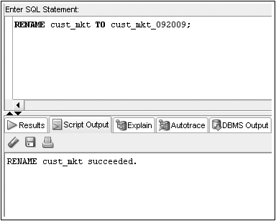
Renaming a Table
RENAME…TO is used to rename a table – the old name is no longer valid
Oracle 11g: SQL

Slide 25
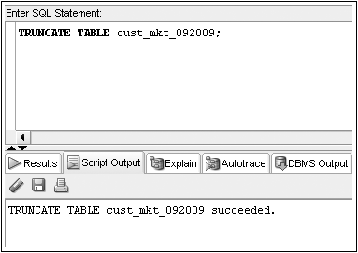
Truncating a Table
TRUNCATE TABLE command – rows are deleted
Structure of table remains
Oracle 11g: SQL

Slide 26
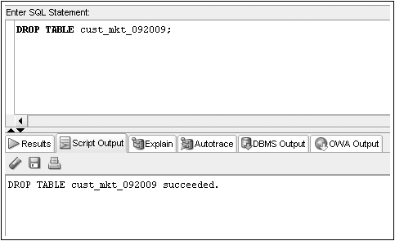
Deleting a Table
DROP TABLE command – table structure and contents are deleted
Oracle 11g: SQL

Slide 27
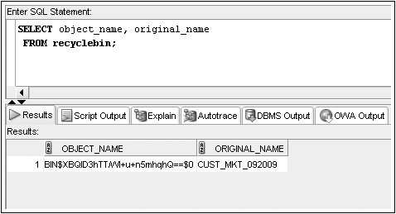
DROP TABLE without
Purge Option
Oracle 10g introduced a recycle bin
Dropped tables can be recovered from the recycle bin
Oracle 11g: SQL

Slide 28
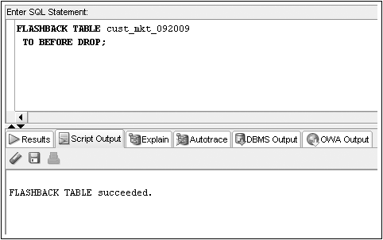
FLASHBACK Command
The FLASHBACK command recovers a table from the recycle bin
Oracle 11g: SQL

Slide 29
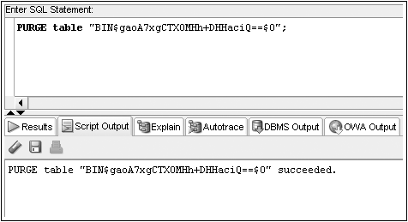
Use PURGE to Remove a Table from the Recycle Bin
Oracle 11g: SQL

Slide 30

PURGE Option Available for
DROP TABLE Command
Using the PURGE option will permanently remove a table from the database
The table will not be copied into the recycle bin
Oracle 11g: SQL

Slide 31
Summary
You create a table with the CREATE TABLE command
Each column to be contained in the table must be defined in terms of the column name, data type, and for certain data types, the width
A table can contain up to 1000 columns
Each column name within a table must be unique
You can change the structure of a table with the ALTER TABLE command
Columns can be added, resized, and even deleted with the ALTER TABLE command
Tables can be renamed with the RENAME...TO command
Oracle 11g: SQL

Slide 32
Summary (continued)
To delete all the rows in a table, use the TRUNCATE TABLE command
To remove both the structure of a table and all its contents, use the DROP TABLE command
A dropped table is moved to the recycle bin and can be recovered using the FLASHBACK TABLE command
Using the PURGE option in a DROP TABLE command permanently removes the table, meaning you cannot recover it from the recycle bin
Oracle 11g: SQL

